Slide 1
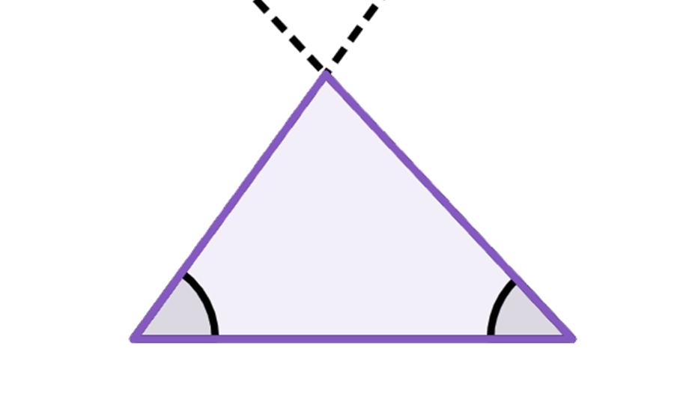
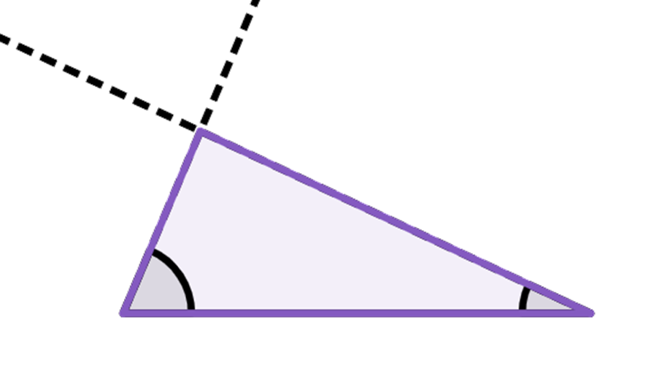
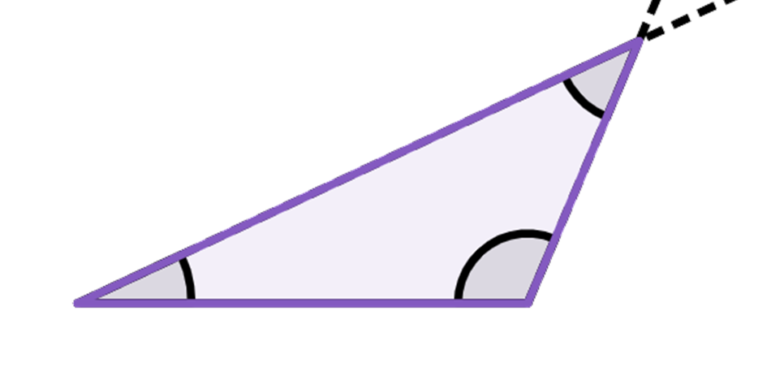
Congruent triangles (ASA and AAS)
Task A: Constructing triangles
1) Construct the following triangles:
a) Triangle ABC, where AB = 7.5 cm, ∠CAB = 54° and ∠ABC = 47°
C
If you measure ∠ACB it should be 79° and BC should be 6.2 cm
54°
47°
A
B
7.5 cm
b) Triangle DEF, where ∠DEF = 67°, ∠EFD = 25° and EF = 8.2 cm
D
If you measure ∠EDF it should be 88° and DE should be 3.5 cm
67°
25°
E
8.2 cm
F
c) Triangle GHI, where GH = 7.1 cm, ∠GHI = 113° and ∠HIG = 42°
I
42°
If you measure GI it should be 9.8 cm and HI should be 4.5 cm
113°
25°
G
H
7.1 cm

Slide 2
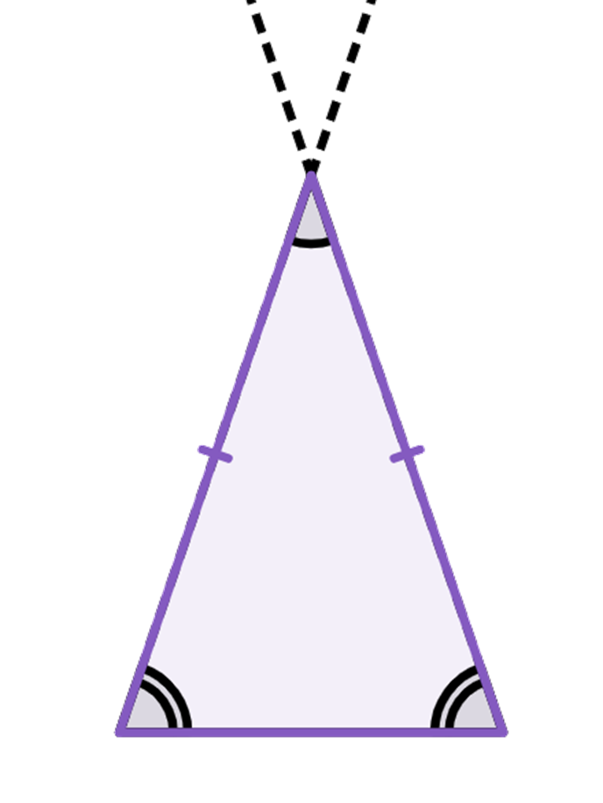
Congruent triangles (ASA and AAS)
d) Triangle JKL, where ∠JKL = 38°, JL = 5.6 cm and KJ = KL
K
If you measure KJ and KL they should both be 8.6 cm
38°
71°
J
L
5.6 cm
Task B: Justifying congruence by ASA/AAS
1) Prove each pair of triangles are congruent by ASA/AAS.
a)
A
4.5 cm
D
F
91°
71°
71°
91°
4.5 cm
B
C
E
AC and EF are corresponding edges and equal, ∠BAC = ∠DEF and ∠ABC = ∠EDF.
Hence, congruent by AAS.
b)
G
J
L
74°
34°
H
34°
29 mm
29 mm
72°
I
K
∠GIH = 180 - (34 + 74) = 72° and ∠KJL = 180 - (34 + 72) = 74°
GI and JK are corresponding edges and equal, ∠HGI = ∠KJL and ∠GIH = ∠JKL.
Hence, congruent by ASA.

Slide 3
Congruent triangles (ASA and AAS)
2) Why are these two triangles not congruent by ASA?
A
D
4.3 cm
4.3 cm
80°
47°
E
47°
80°
B
C
F
Although, the three interior angles of both triangles are the same. The two edges of 4.3 cm are not corresponding edges in the triangles.
3) Given a parallelogram ABCD, prove that triangle ABC is congruent to triangle ACD by ASA/AAS.
A
D
∠DAC = ∠ACB as they are equal interior alternate angles.
AC is a shared side.
B
C
∠DCA = ∠BAC as they are equal interior alternate angles.
Hence, triangle ABC is congruent to triangle ACD by ASA.
Alternatively:
A
D
AD = BC as they are opposite sides of a parallelogram.
∠DAC = ∠ACB as they are equal interior alternate angles.
∠DCA = ∠BAC as they are equal interior alternate angles.
B
C
Hence, triangle ABC is congruent to triangle ACD by AAS.
4) Point E is the midpoint of AC and BD. Prove that triangle AEB is congruent to triangle ECD by ASA/AAS.
D
DE = EB, as E is the midpoint of BD.
A
E
∠AEB = ∠DEC as vertically opposite angles.
∠ABE = ∠EDC, as they are equal interior alternate angles.
B
C
Hence, triangle AEB is congruent to triangle ECD by ASA.
Mathematics in Education and Industry.
v2.3

